Slide 1




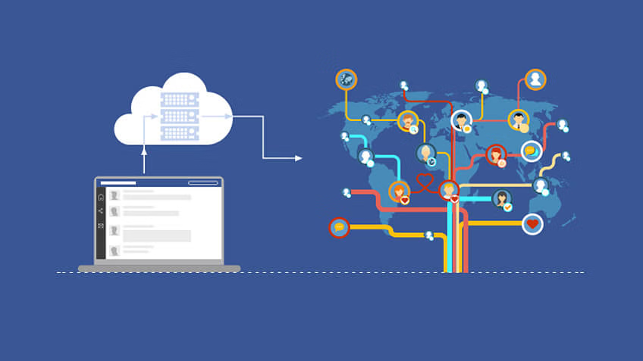
Facebook use Big Data
CASE STUDY (BDT)

Slide 2






Meet Our Team
Om Muddebihal
Awwal Choudhari
Mihir Sawant
Anil Vhatkar
Atharva Kulkarni

Slide 3
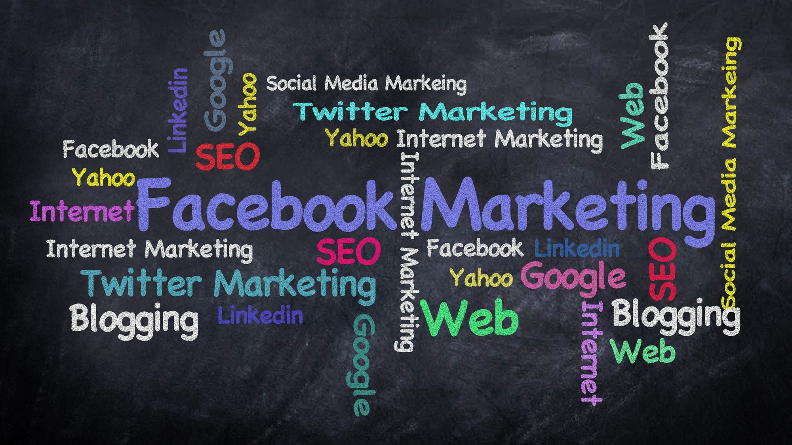
Problem Statement
Data, Analytics, AI, and robotics, today, the tech discussions revolve around these topics. With the significant development technology has made in our life, it has also brought forth some interesting insights. One of them is the large volume of data that we are creating every day. Facebook, which brought the social media revolution, generates around 500+ terabytes of information every day. All these pieces of information hold great significance. But deploying conventional methods to extract insight from this data is not feasible. Here comes the role of Big Data.

Slide 4


Relationship Between Facebook and Big Data
Facebook has been leveraging Big Data technology to extract meaningful insights. Every activity of the Facebook user, like the active hours on Facebook, photos, videos, liked photos, games that you play, and posts liked etc. All this information is collected by Facebook, assessed and analysed. Based on this, Facebook is able to make personalised recommendations. With every passing second, new data is being fed into the system.

Slide 5
Quick Snap at Mounds of Data Being Fed in Facebook
01
03
02
04
Photos
Status Updates
Every 60 seconds, Facebook users upload around 136,000 photos
Comments
And 293,000 status updates are posted on Facebook every 60 seconds
Daily Data
The comment section is busted 510,000 comments every minute
Every day, Facebook generates 500 + terabytes of information.

Slide 6



Providing personalised experience
How Does Facebook Use This Data?
It helps in improving the services
To ensure the safety and security of the user on the platform
It also helps Facebook assess the analytics, thereby predicting the success rate of the ads run on this platform.
With the help of this information, Facebook is able to support research.

Slide 7
Ways Facebook is Using Big Data
01
03
02
04
Analysis of Text
Targeted Advertising
You would agree that a large volume of data is added to Facebook. With DeepText, Facebook tries to extract the meaning of the words added to the posts.
Facial Recognition
Advertising is one of the areas where Facebook uses Big Data technology to promote several businesses. However, it is a great tool for promotion and branding but is also controversial because it tracks the user’s activity.
Analysing Likes
With the DeepFace technology, Facebook analyses the image and, based on it, recommends the name of the friends for tagging. This technology also assesses whether the two different images are the same or not.
Facebook analyses the activities of the user. Assessing the likes helps Facebook predict the intelligence, emotional stability and religious sentiments of the people.

Slide 8






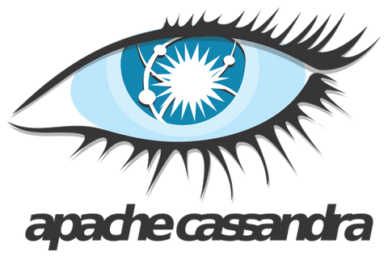


TECHNOLOGY USED BEHIND FACEBOOK’S BIG DATA

Slide 9


Use Case 1 :
Takes You Down The Memory Lane: The Flashback videos
On the occasion of the platform’s 10th anniversary, Facebook had presented to its users the choice of viewing and sharing a video that unearths the path of their activity on the platform from the date of registration until the existing time. As mentioned above, termed as the “Flashback,” this video is basically a compilation of photos and posts that gained the maximum comments and likes, which are accompanied by nostalgic background music.
These videos are also presented to users on occasions like their “friendversary”, i.e the anniversary of the day they became friends on the platform or on the occasion of the user’s birthday.

Slide 10

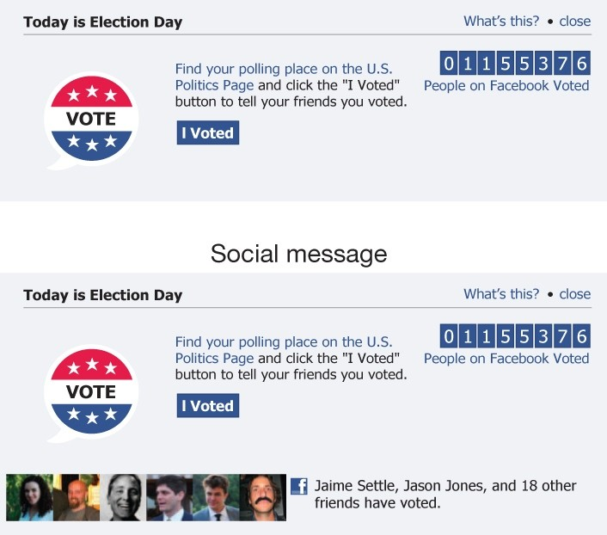
Use Case 2:
The Social Cause:
“I Voted” Experiment
Around the end of 2010, Facebook conducted an extensive social experiment in which it generated a sticker that enabled its users to announce “I Voted” upon their profiles.
This experiment was conducted amidst the 2010 midterm elections and had quite an effective outcome. Upon laying their eyes on the I voted sticker, the users had more chances of voting and also of being more expressive regarding their voting act, as they observe their friends indulging in the action.
As claimed by the Facebook scientists, the sticker — and the peer pressure pertaining to it caused 340,000 more people to vote in the 2010 midterm elections.

Slide 11
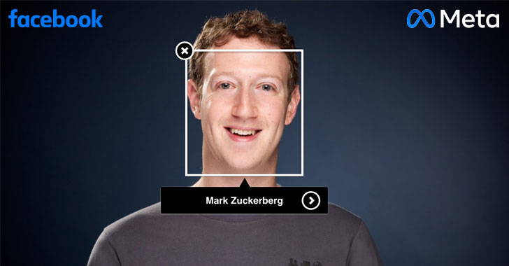
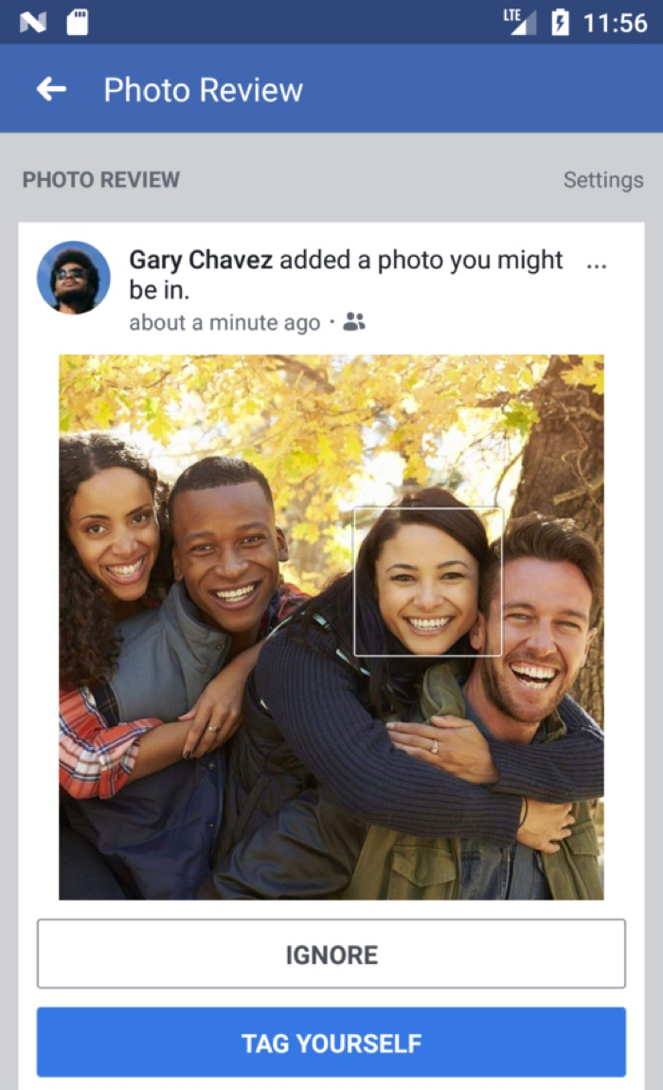
Use Case 3 :
The Tagging Game:
Facial Recognition
Facebook employs image recognition technology that analyzes pictures and videos against other images to detect details like objects and people. It uses the deep learning application "DeepFace" to teach the platform to identify people in photos. Facebook claims DeepFace is more accurate than humans in determining if two different images depict the same person.
In 2010, Facebook introduced facial recognition for the US market through its tag suggestions tool, which would inadvertently tag people in uploaded photos by scanning faces and suggesting names. While users could deactivate it, the feature was enabled by default without explicit consent, leading to privacy controversies.
In December 2017, the tool was rebranded as "face recognition" and Facebook made it easier for users to turn the feature on or off. However, in 2019, amidst concerns over unauthorized collection of biometric data, Facebook made face recognition an opt-in feature in an effort to be more privacy-oriented.

Slide 12
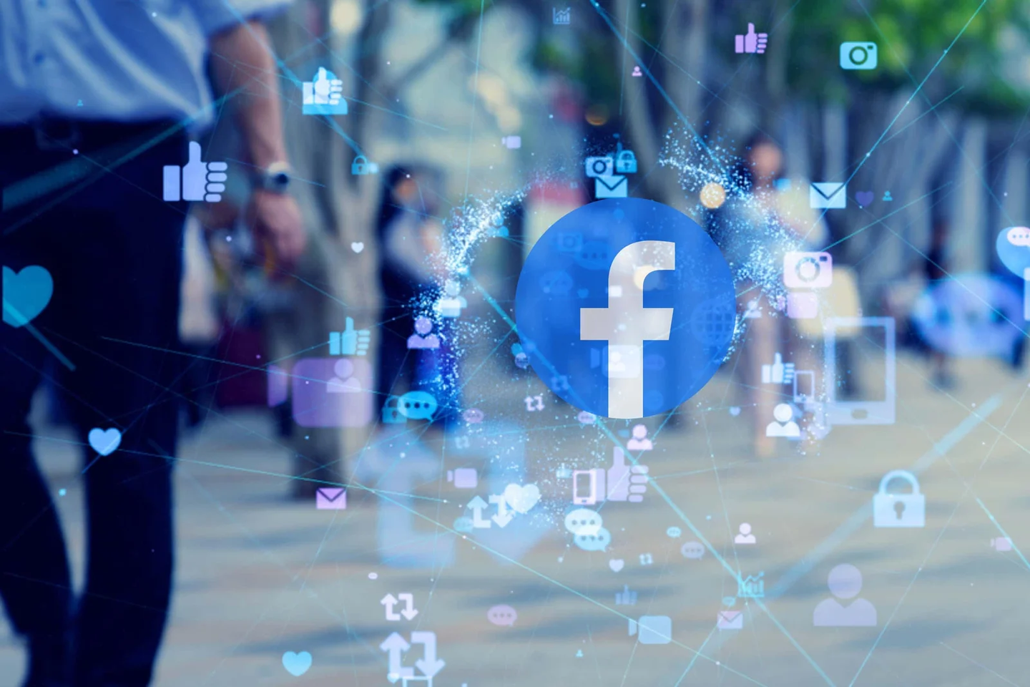
Conclusion
There is no doubt that Facebook is one of the largest Big Data specialists, dealing with petabytes of data, including historical and real-time, and will keep growing in the same horizon. While the world is coming closer together on this platform, Facebook uses technologies to track those connections and their presence on or outside its walls to fetch the most suitable posts for its users. From our friends, our location, our looks, our occupation to our likes and dislikes, Facebook has a lookout for everything! The platform possesses a detailed and advanced level of data regarding its users. The more users that adopt Facebook, the more data is garnered by the platform. By being massively engaged in its capacity for collecting, storing, and interpreting data, Facebook has placed Big Data at the heart of its operations. One thing is for sure, it is Big Data that has propelled Facebook, a small-time Harvard dorm startup into the constellation of some of the biggest corporations on earth of all times!

Slide 13




